Slide 1

DriverPass System Analysis
Josh Cantu
Notes:
[No speaker notes required for this slide.]

Slide 2

System Requirements
Functional Requirements
Use of multiple roles. Roles like Admin, Instructors, and Students
Non-functional Requirements
This service will be scalable and be able to grow or shrink as needed
Internet browser access only
Notes:
Roles:
Allows people involved to “stay in their lane”. People shouldn’t be able to manipulate data they shouldn’t be changing.
Scalable:
It allows a smooth transition with little downtime as more instructors and more students start to utilize this service.
Internet Access:
Allows multiple users to utilize this service from any device.

Slide 3
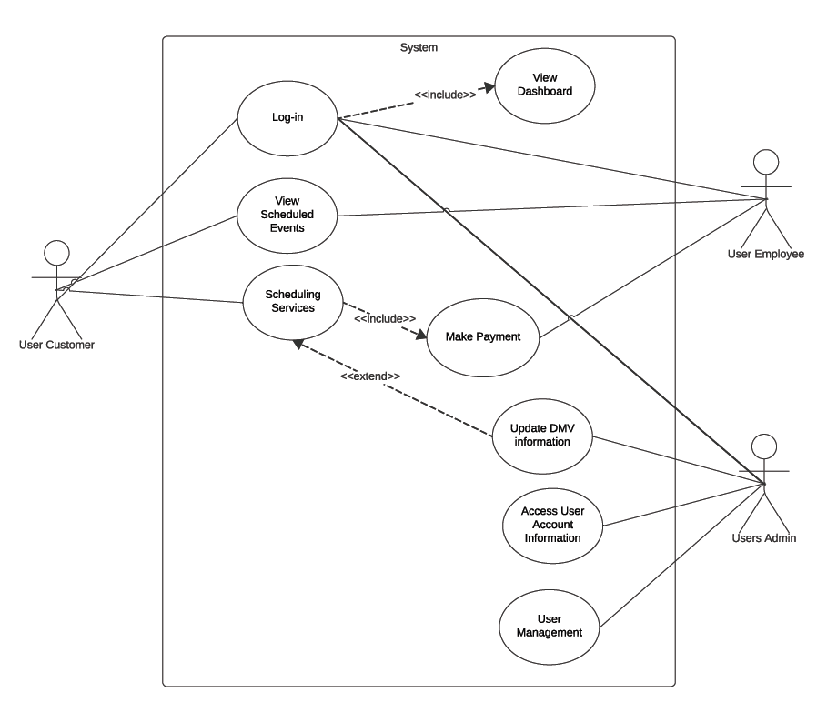
Use Case Diagram
Notes:
The main flow is from the student and the employee. The admin provides support to both students and employees. Students will be able to log in to their accounts and view their schedules and lesson plans. Somethings will apply to the type of employees, but most will be able to view their schedule and log into the same system.

Slide 4
Activity Diagram
Notes:
The diagram goes over the login process. Only two real scenarios can happen. The person signing in either does or does not have an account and the flow will determine appropriately.
Once they are logged in they will be able to view their dashboard.

Slide 5
Security
Network traffic will be encrypted.
Backend will be upgradeable
Proper permissions will be applied to appropriate roles.
Users will be provided the appropriate permissions
Notes:
Security is everyone’s duty. Could have the best security system available but someone clicks on a link that is unsafe and the whole system is compromised. First and foremost is that everyone should be educated on proper safety protocol. Outside of that, all traffic going in and out will be encrypted to protect everyone’s information. Providing the user with their proper permission will ensure there are no accidental changes that could affect the whole system.

Slide 6
System Limitations
Not ADA complaint
Not support FaaS or another server-less architectures
Notes:
We aim to allow the full ADA compliance to allow users who are disabled to utilize our site. The first iteration may not be immediately available, but we aim to be as close to fully compliant as possible.
Server Technology is mature enough to handle the current scalability.

